Slide 1
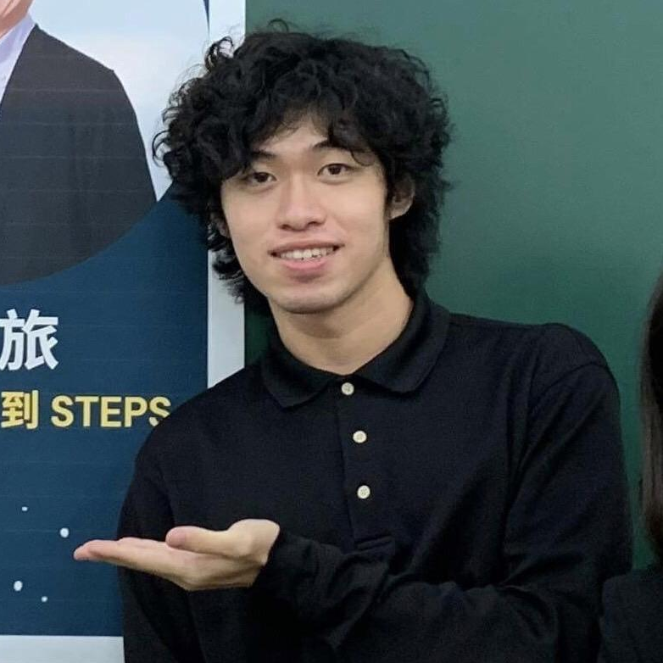
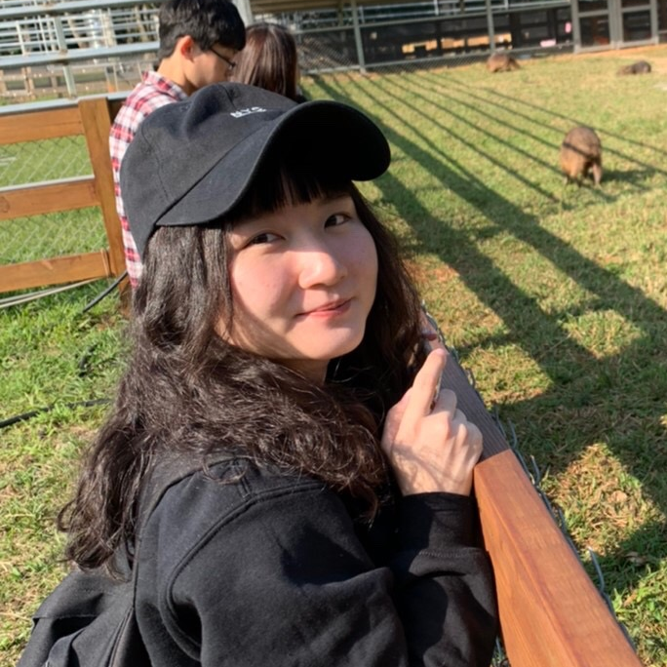

Group5
Leo Shr
NTHU ISS 110
110078509
Karen Chiu
NTHU ISS 110
110078506
Joanne Lee
NTHU ISS 110
110078501

Slide 2
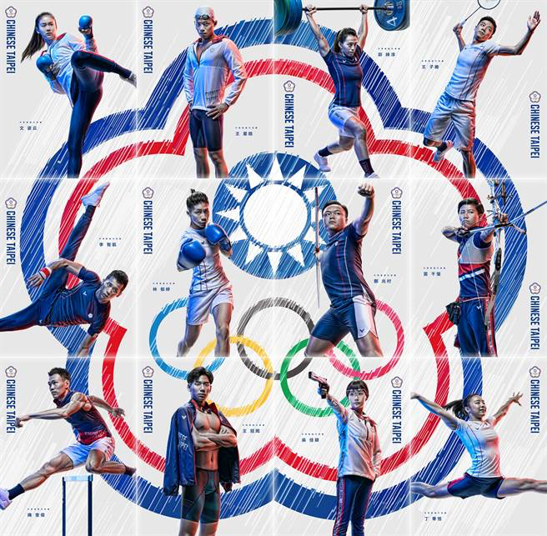

Background
In Tokyo Olympics, Chinese Taipei won a total of 12 Olympic medals, including 2 gold medals, 4 silver medals, and 6 bronze medals. That was the best record since the 1984 Los Angeles Summer Olympics.
Based on our mid-term project, we want to dig deeper into the documents of athletes.

Slide 3
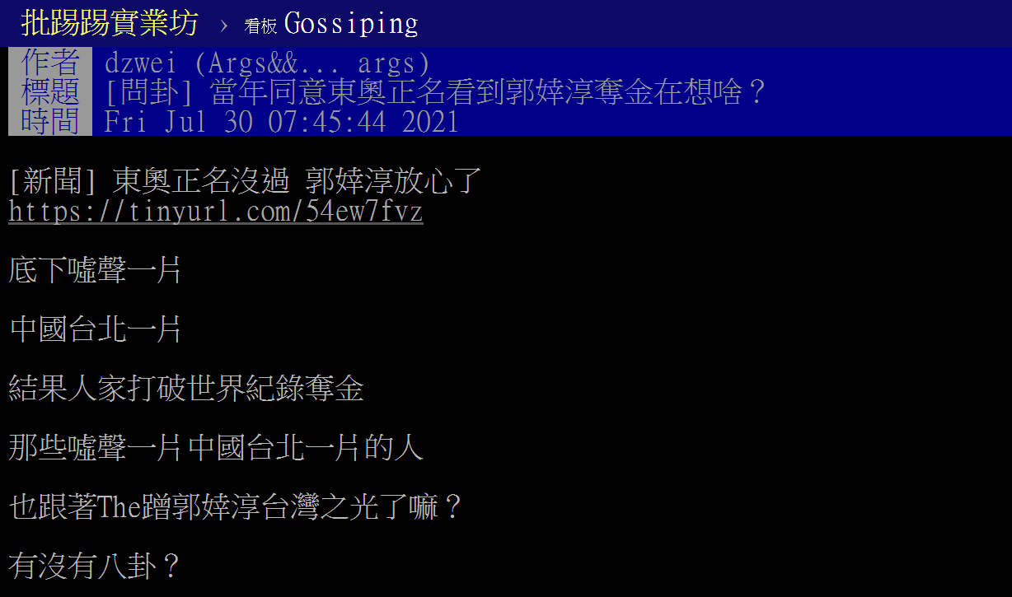
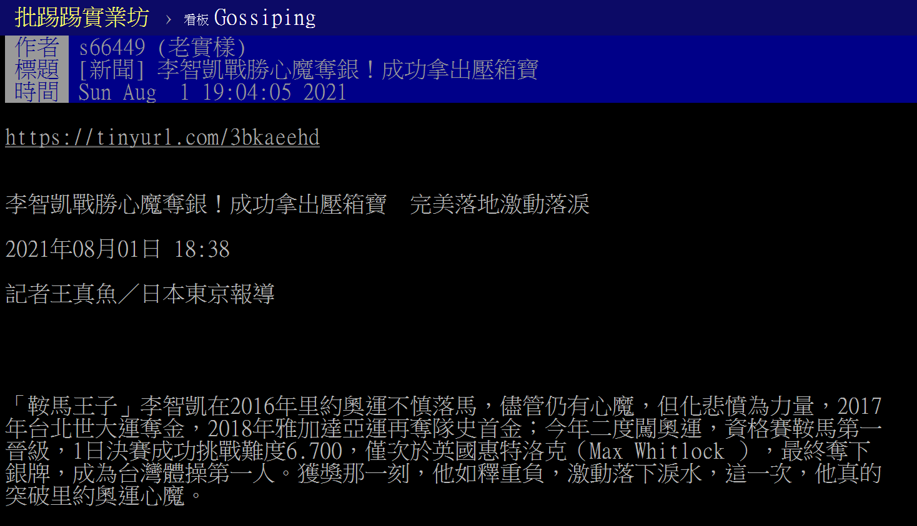
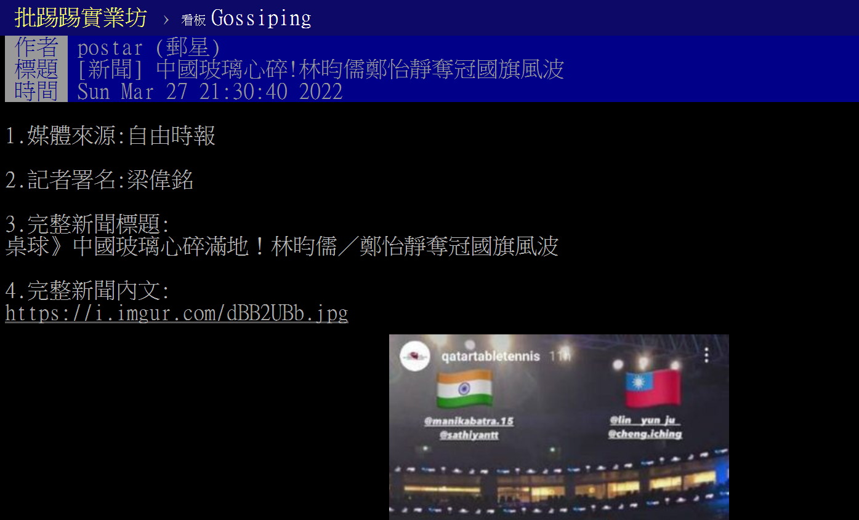
Motivation
Are you curious how many people will reply to you after writing the article?

Slide 4
Objective
We want to predict how many comments an article will have.
And further help those who want to be a topic of conversation on PTT.

Slide 5
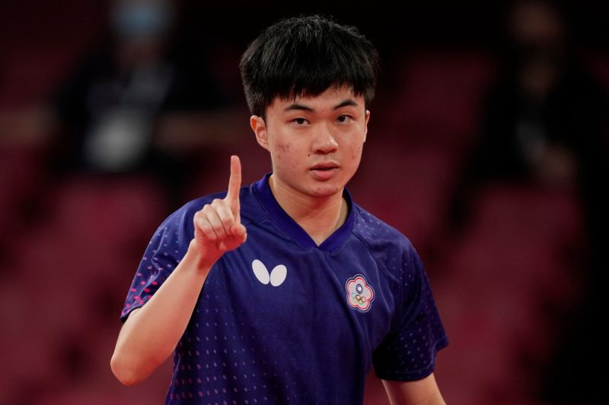
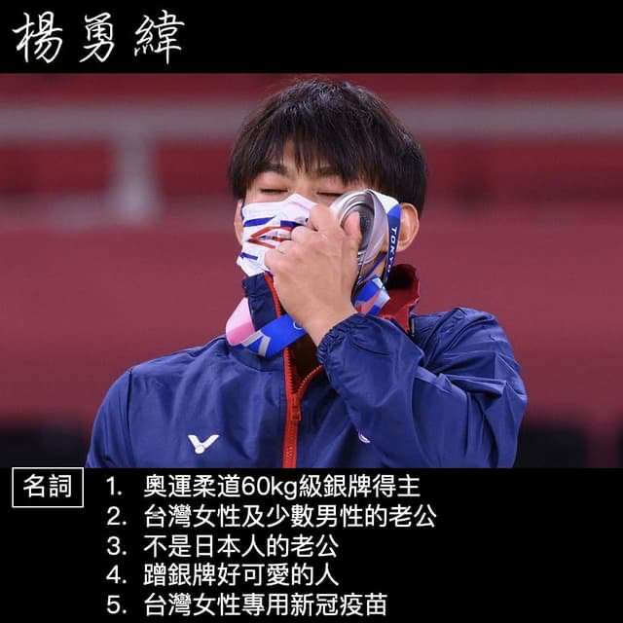
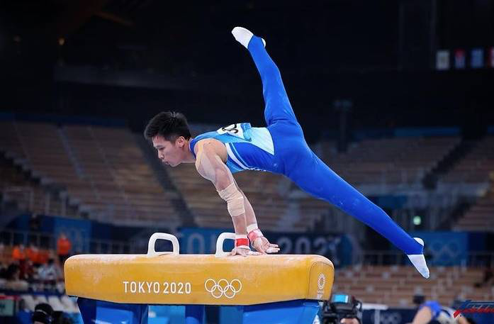
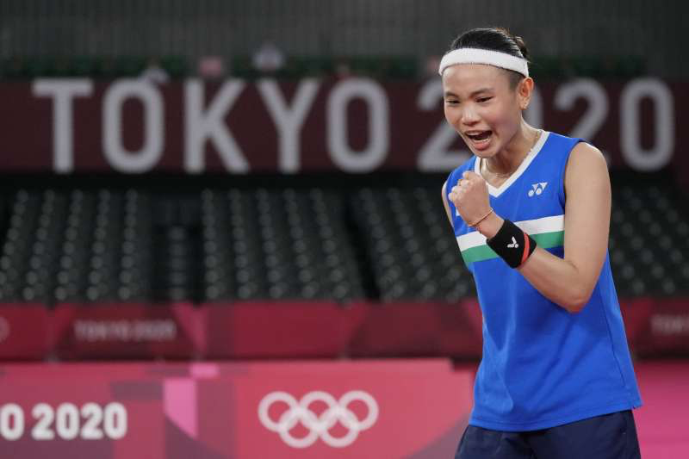
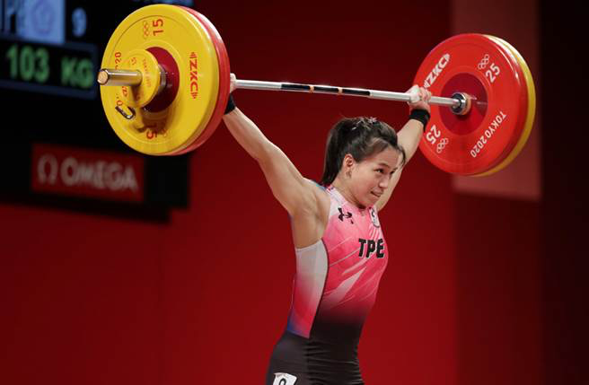
Topic
Using BERT and Ruled Based Sentiment Analysis to Predict PTT Public Opinion Responding Level
透過文章內文進行多標籤極性分析以預測輿論影響程度

Slide 6
Adopted Technique
Technical
Data Preprocessing ok
Data cleaning (Stemming + stopword + ckip- tokenization )
Beautiful Soup
TextCloud
Adopted Unsupervised Learning for training dataset ok
BERT + Transfer learning -> Unspervised Learning (Python)
Ruled Based optimalzation ok
Keymoji (Ruled Based Sentiment dictionary) ing 念紘
Document
預測1 Decison Tree (unstable) (R) Leo
Bagging (Boosting + aggregation) ® RMSE起伏大 採用 ok
k selection (k >=2 原因: 上影片)
Adaboost: Boost + lr -> RMSE = ? ® RMSE起伏小 ok
預測2 RF
看看能不呼叫k-fold validation ，如果不行(1) 影片 (2) 給Leo 用R ok
Random Forest ( Bagging + decision Tree + drop out) (Python+ R) (跑一個小的) ok
看vector 影片特性
Plot(RF) (Optional)
評估 (解釋RF預測不準) (Optional) ® Inductive Deductive
不準?提出假說 (情緒影響是否正向 正向負向影響留言數量)
Solution: SEM- + Boosting

Slide 7
Adopted Technique
Data Preprocessing
Data cleaning ( stopword + ckip- tokenization )
B4S
TextCloud
BERT + Transfer learning
Ruled Based Sentiment analysis Keymoji
Model selection
Adaboost (Boosting + learning rate) ® RMSE but 起伏小 ok
Bagging ® RMSE起伏大 採用 ok
Decision Tree
k-fold Validation
Random Forest
Solution: SEM- + Boosting

Slide 8
Flow Chart

Slide 9
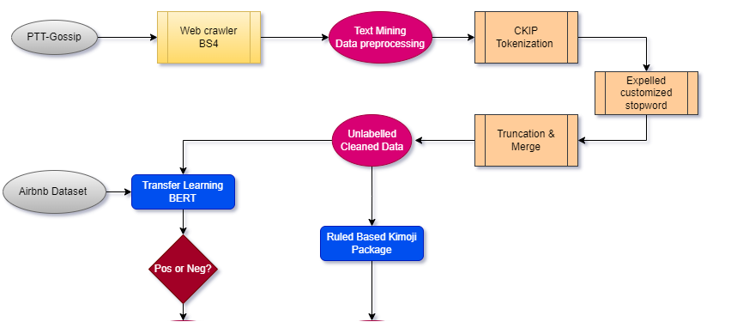

Slide 10
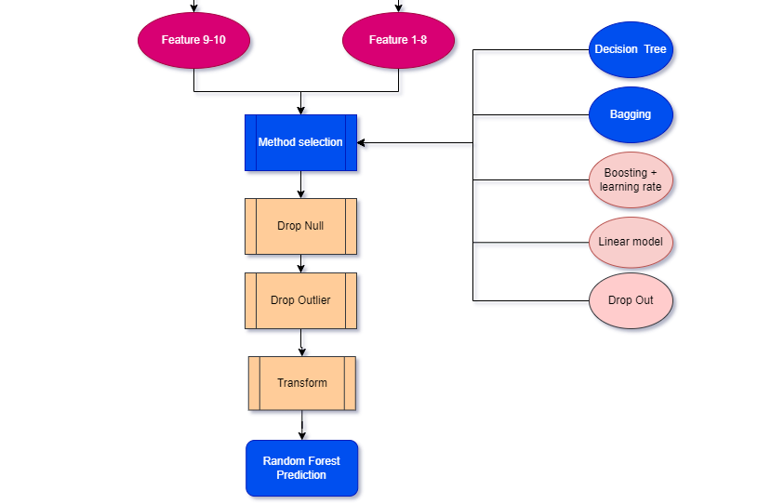

Slide 11
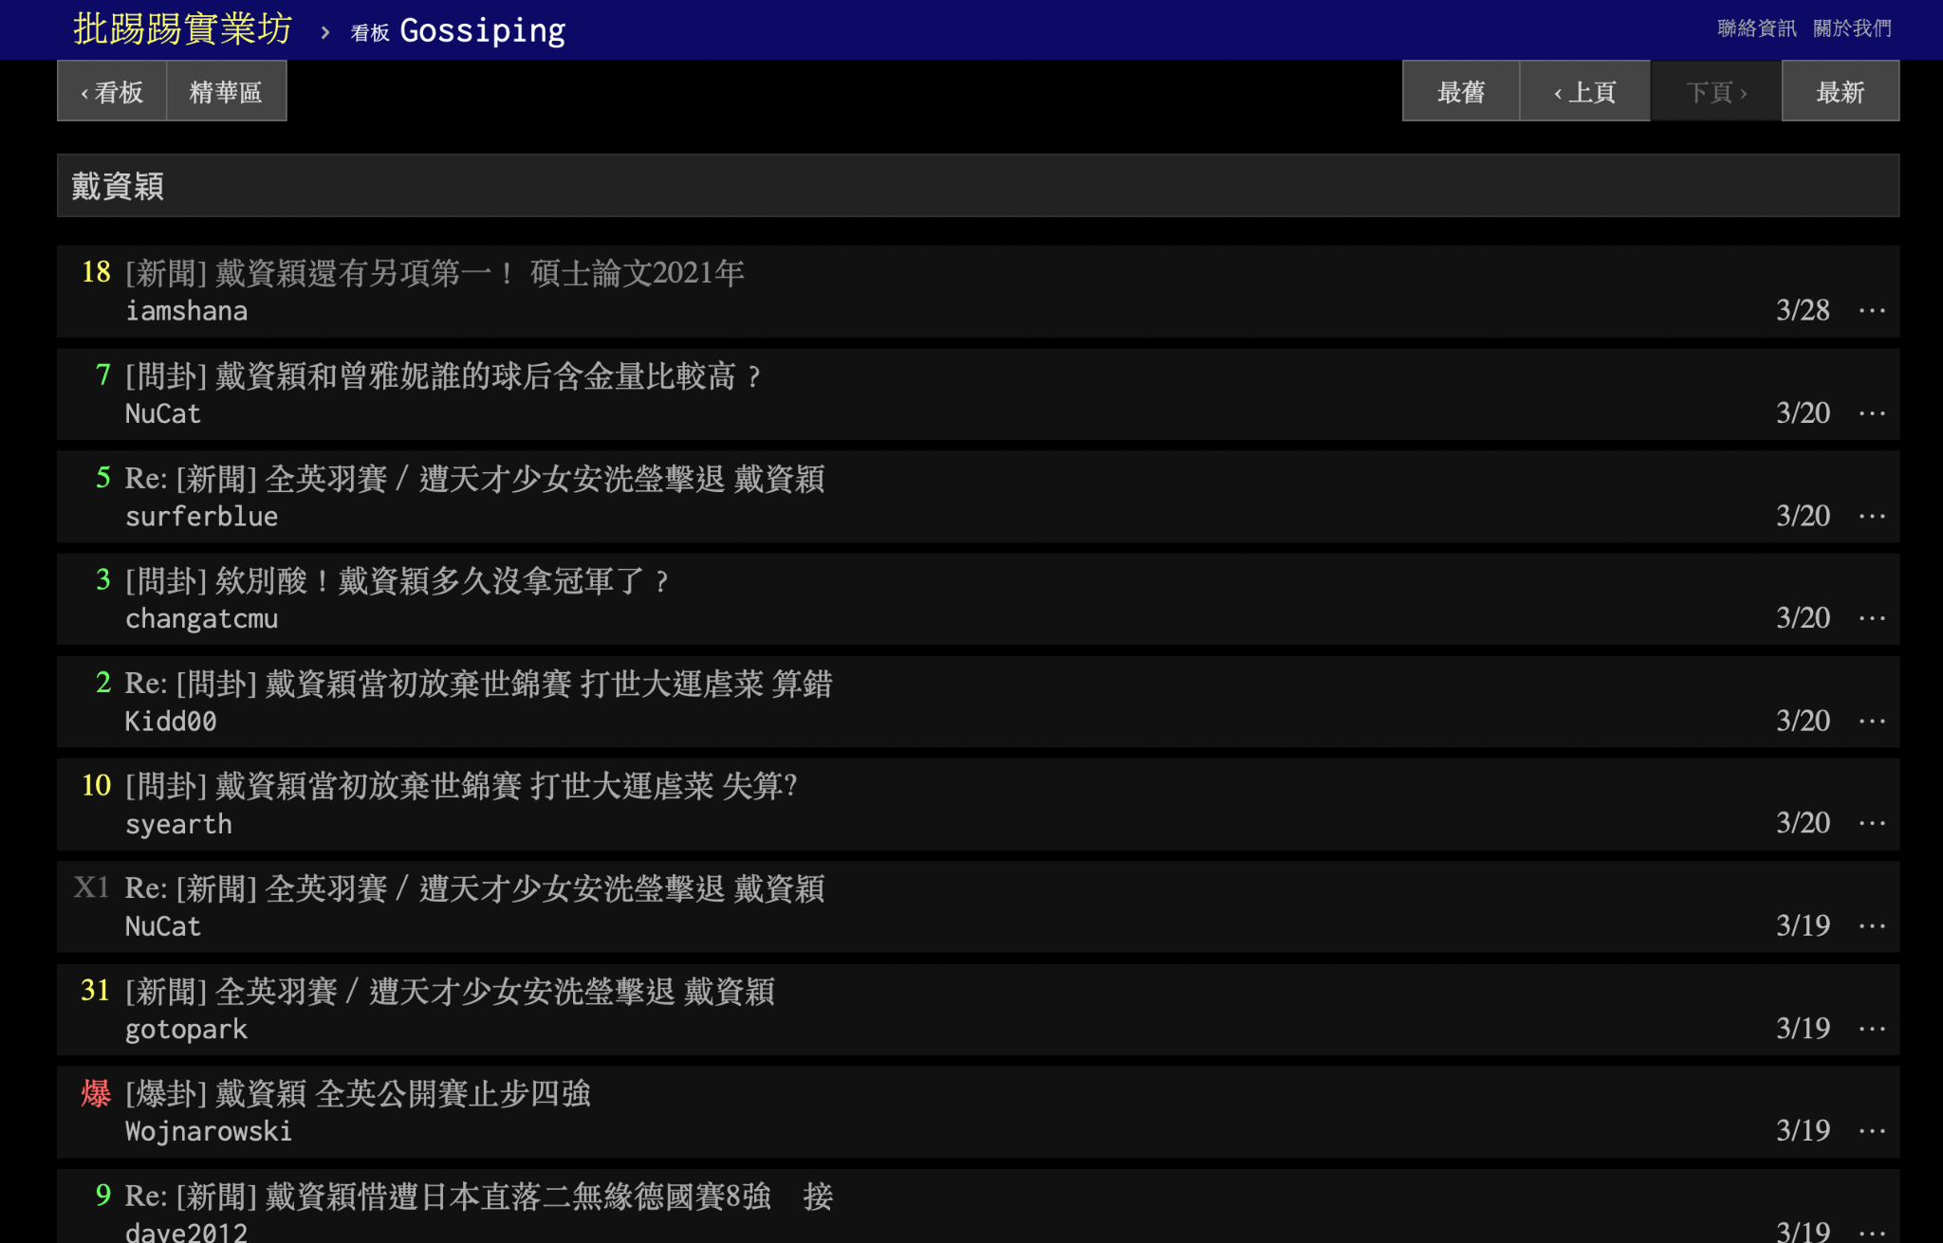

Data Source
PTT Gossiping
Name of athlete
Tai Tzu-Ying (戴資穎)
Lin Yun-Ju (林昀儒)
Kuo Hsing-Chun (郭婞淳)
Lee Chih-Kai (李智凱)
Yang Yung-wei (楊勇緯)

Slide 12
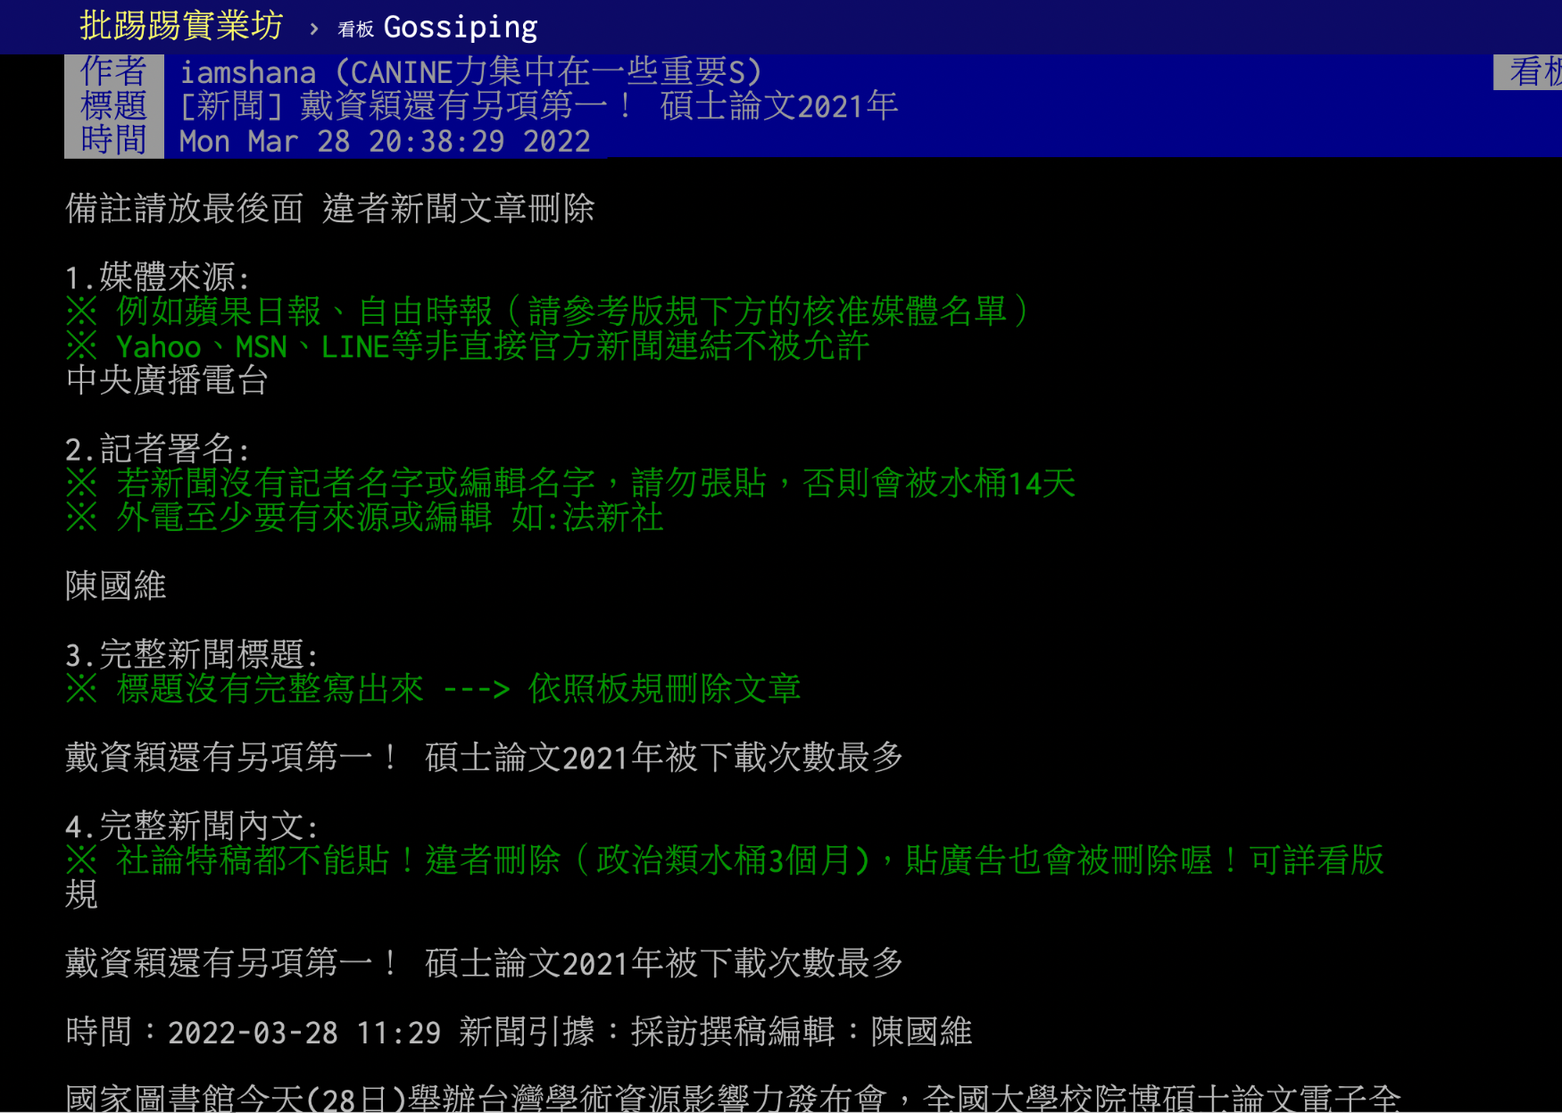
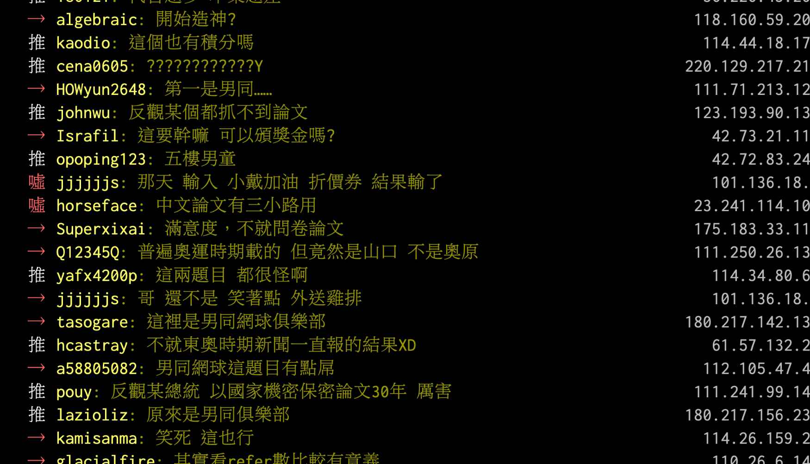
Data Structure
Athor / Title / Time
Content of article
Numer of Comments

Slide 13
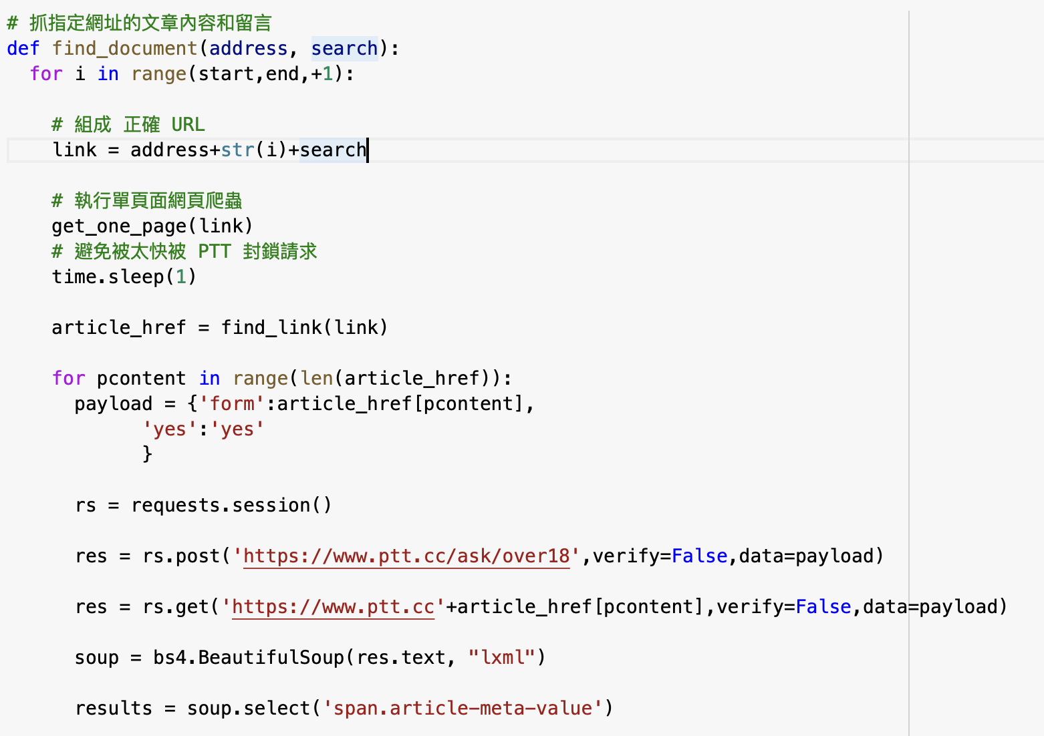
Technique
Web scrapping
BeautifulSoup
store to .csv files

Slide 14
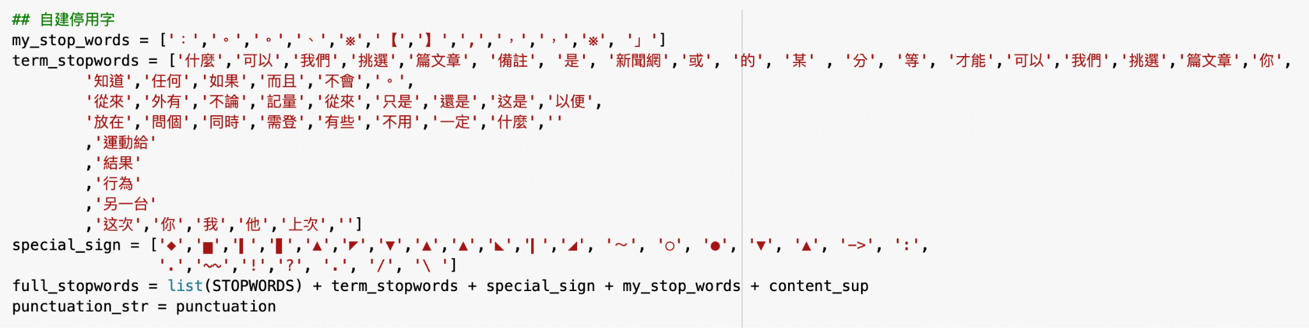
Technique
Tokenization CKIP
Define our stop words

Slide 15
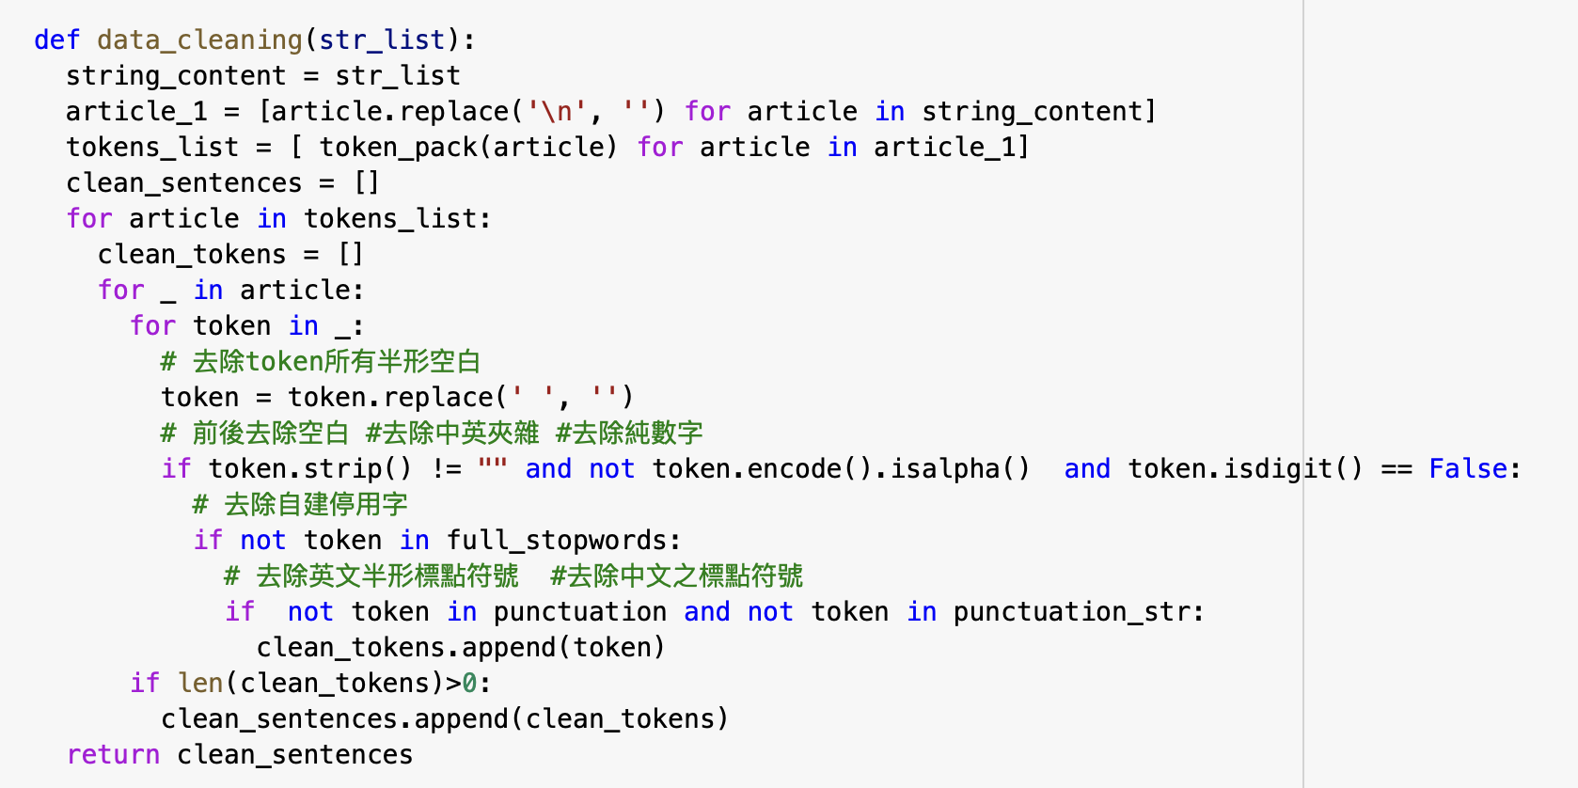
Technique - Data Cleaning

Slide 16
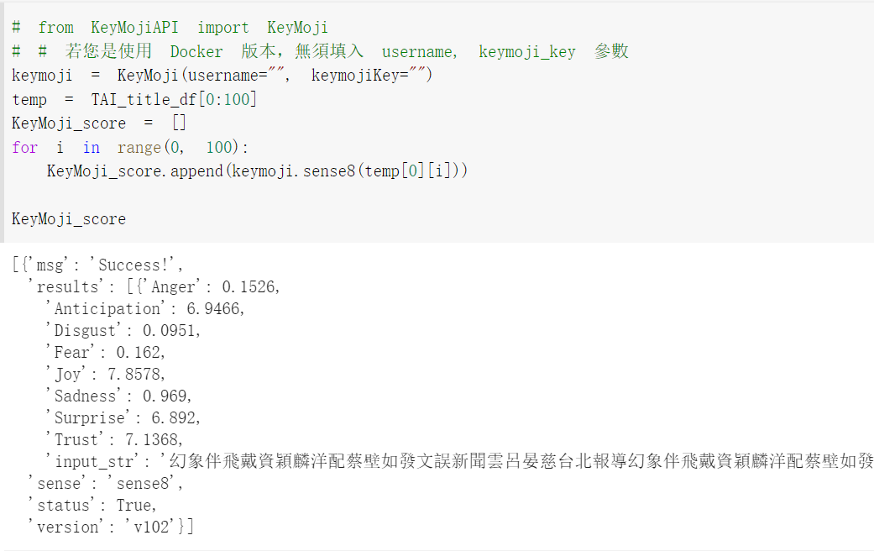
Technique - Ruled Based Sentiment Analysis Keymoji Package
Keymoji package
8 Sentiment Score
Anger
Anticipation
Disgust
Fear
Joy
Sadness
Surprise
Trust
Notes:
資料來源：https://api.droidtown.co/KeyMojiAPI/document/#KeyMoji_3

Slide 17
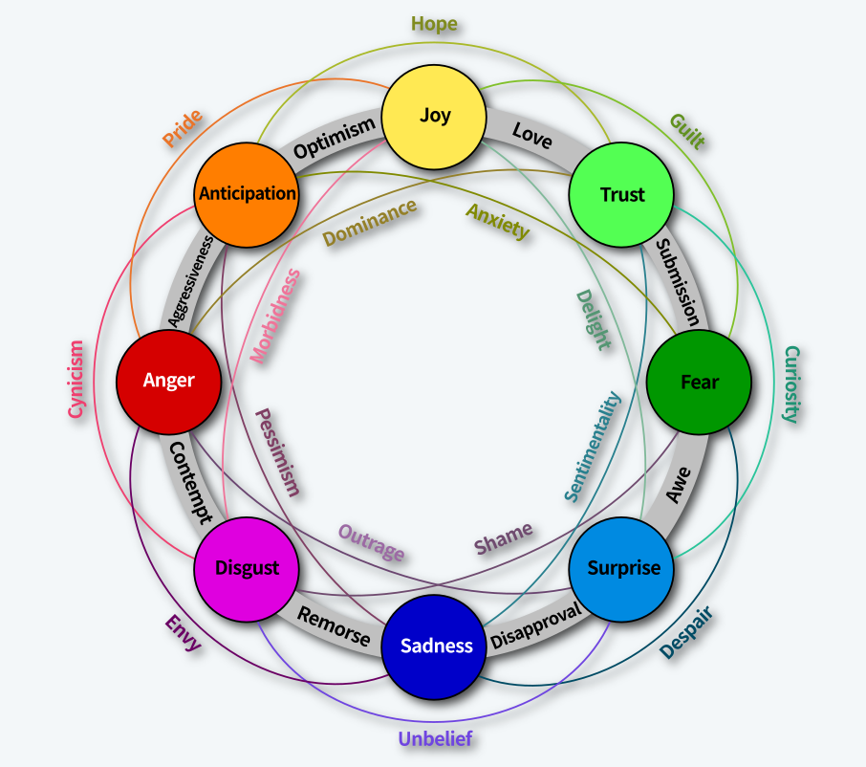

Slide 18
Transfer learning BERT

Slide 19
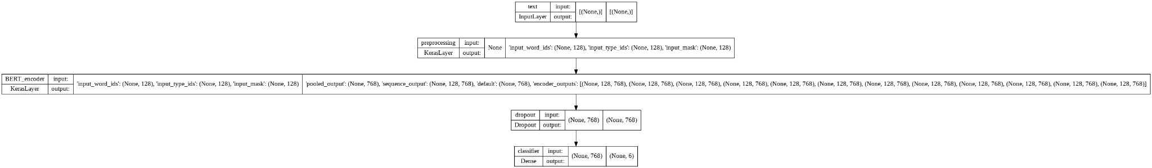
Technique - Transfer learning BERT
Problem: PTT reviews have no label required for classification
Transfer Learning:
We use Airbnb reviews data (Mandarin data with labelled) to fit the BERT Pretrained model
Classification task
Then, we applied fitted BERT model to the PTT Gossiping data to do the classification task
Code Link

Slide 20
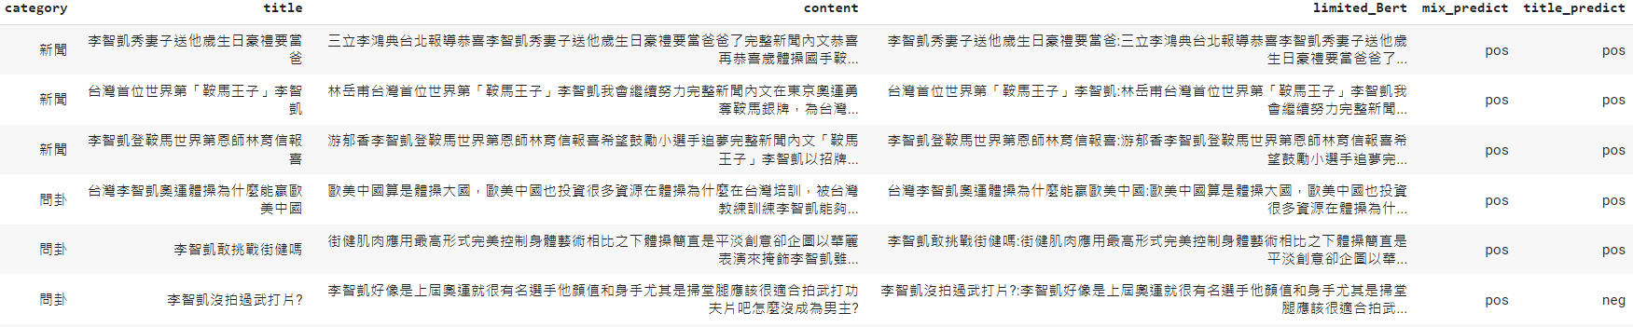
Output Demo:
In order to avoid the problem of a fake title,
Concated the title and content together
(Truncated the string under 123 + 3 (CLS, SEP, UNK) to form the second prediction of classification prediction.)
2. Also, it improved the following rule-based algorithm result.
It can alleviate the fear of judging a book by its cover.

Slide 21
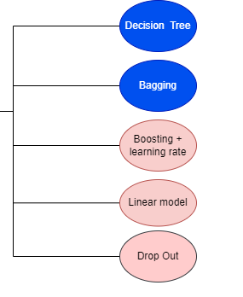
Method Selection &
Tuning Skill

Slide 22
Technique - Predictive Model Selection
Improve linearity:
Log Transform the continuous variables
Comparison the RMSEs:
K-fold Algorithm (LOOCV)
Tree-based Model v.s. Linear Model?
K-fold Validation ( k = n) | In-sample RMSE | Out-sample RMSE
Simple OLS Model | 0.8172109 | 0.8520548
Simple Decision Tree | 0.7562913 | 0.8667383
Very Closed

Slide 23
Technique - Method Selection
Bagging
K-fold Validation ( k = n) | In-sample RMSE | Out-sample RMSE
Bagged OLS Regression | 0.8172109 | 0.8520548
Bagged Decision Tree | 0.7495758 | 0.7558893
Boosted
K-fold Validation ( k = n) | In-sample RMSE | Out-sample RMSE
Adaboost OLS Regression | 0.844557 | 0.8646697
Adaboost Decision Tree | 0.854412 | 0.8779588
Appearently, “Bagged Decision Tree” won!
But it’s too stable. Therefore, we applied RandomForest (Bagged Decision Tree + Drop out)

Slide 24
Decision Tree + Kimoji

Slide 25
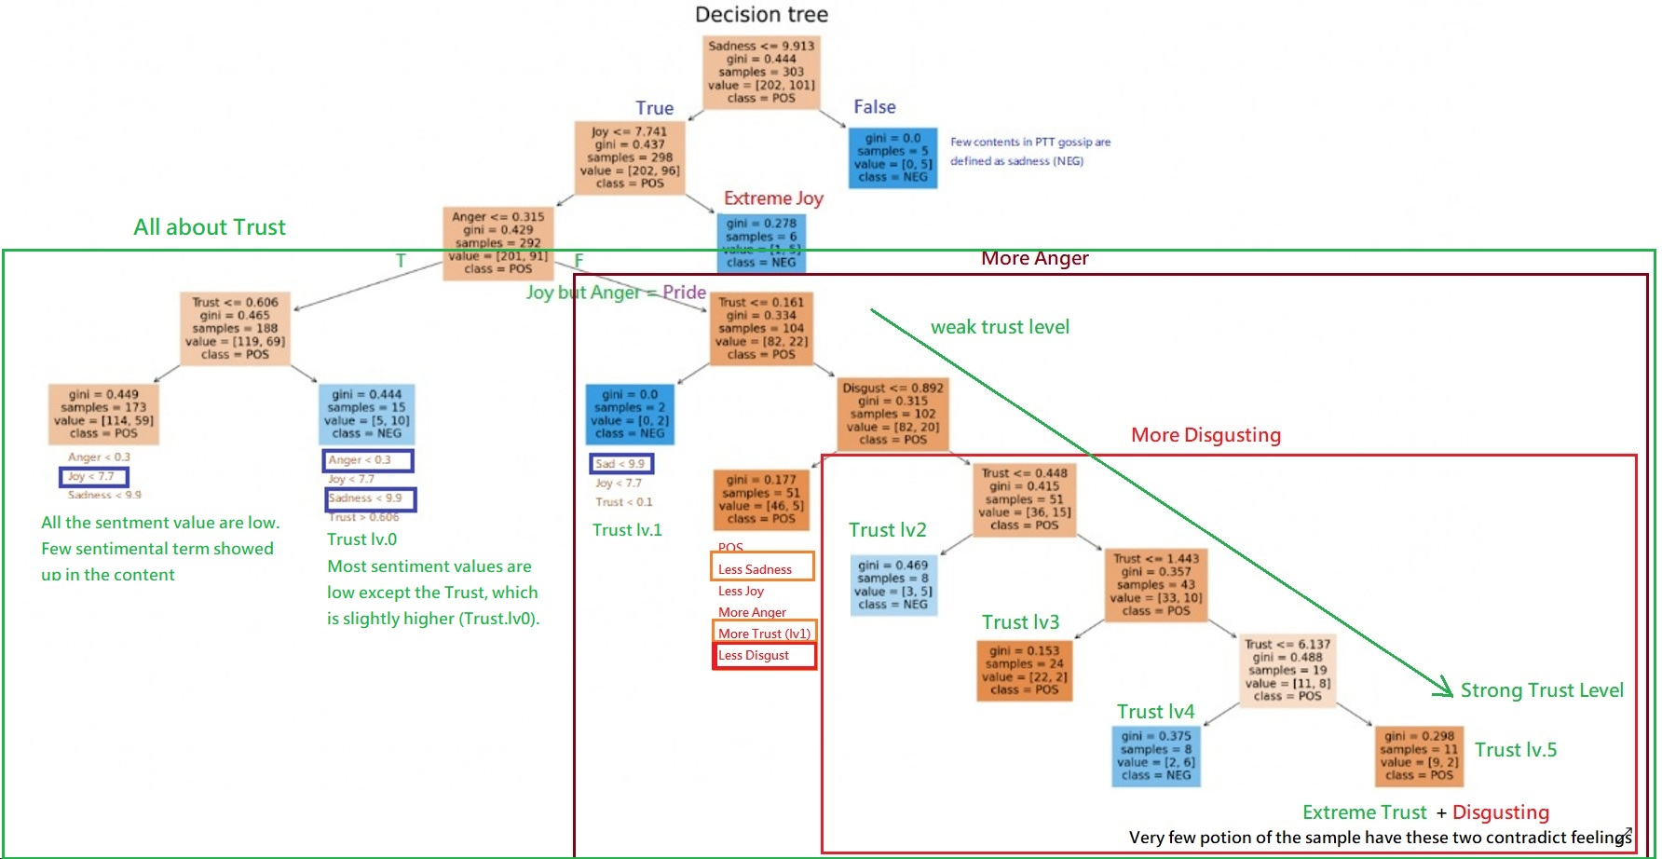

Slide 26
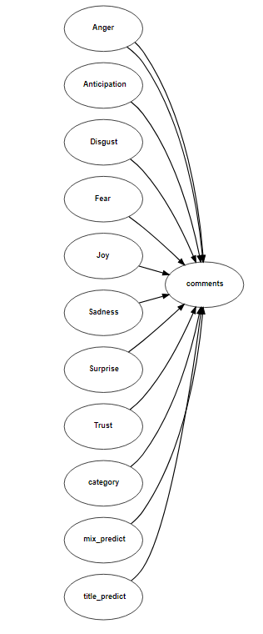
Random Forest

Slide 27
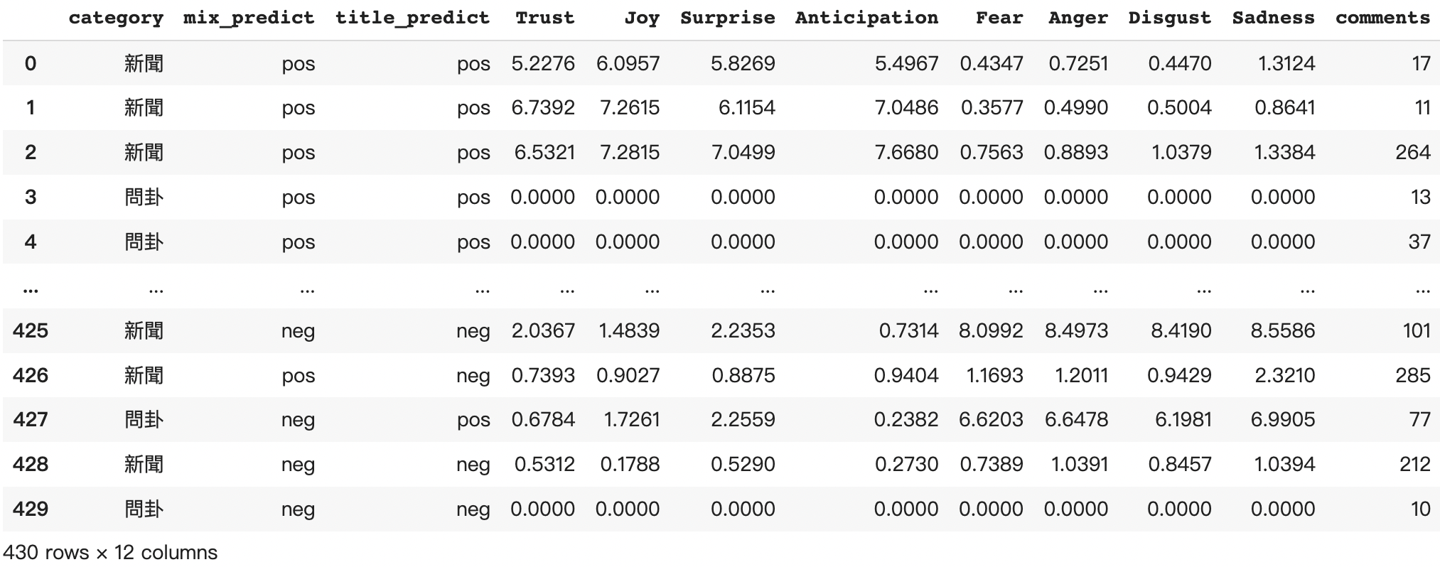
Random Forest - Original Dataset (n = 430)
Moverover, we take categories (新聞 / 問卦...) into account.

Slide 28
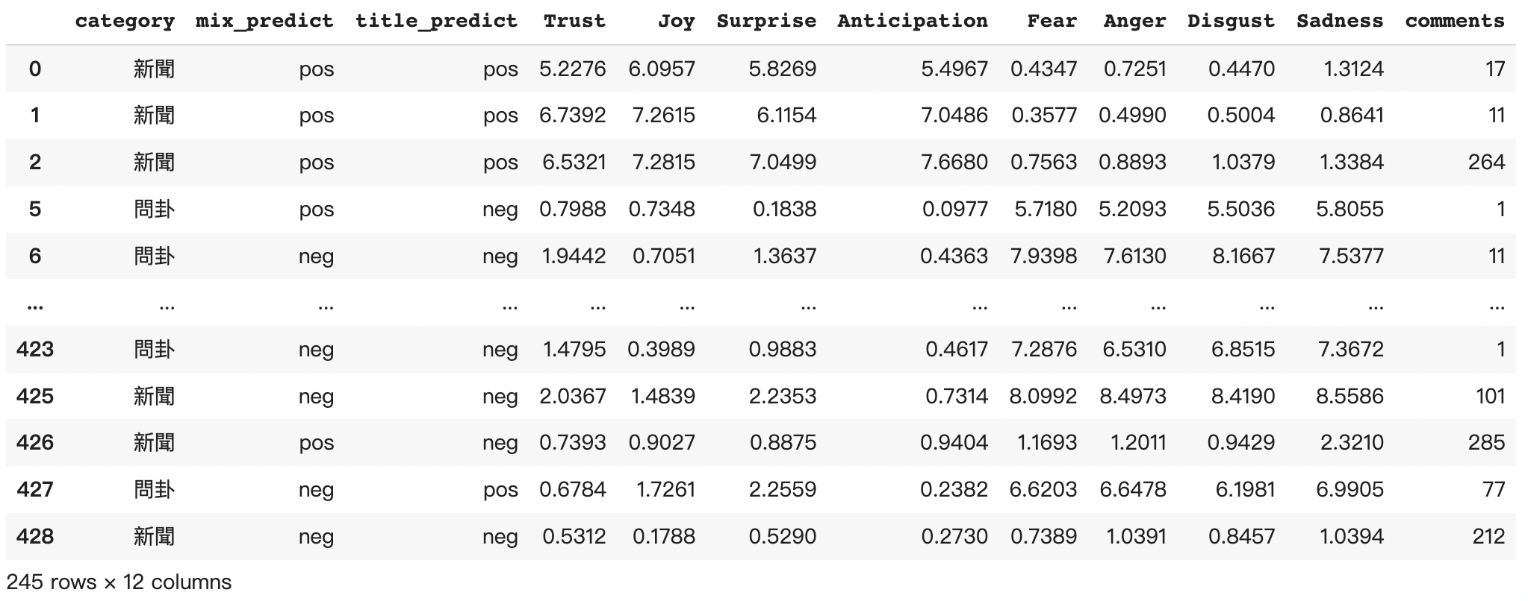
Random Forest - Remove Keymoji = 0

Slide 29
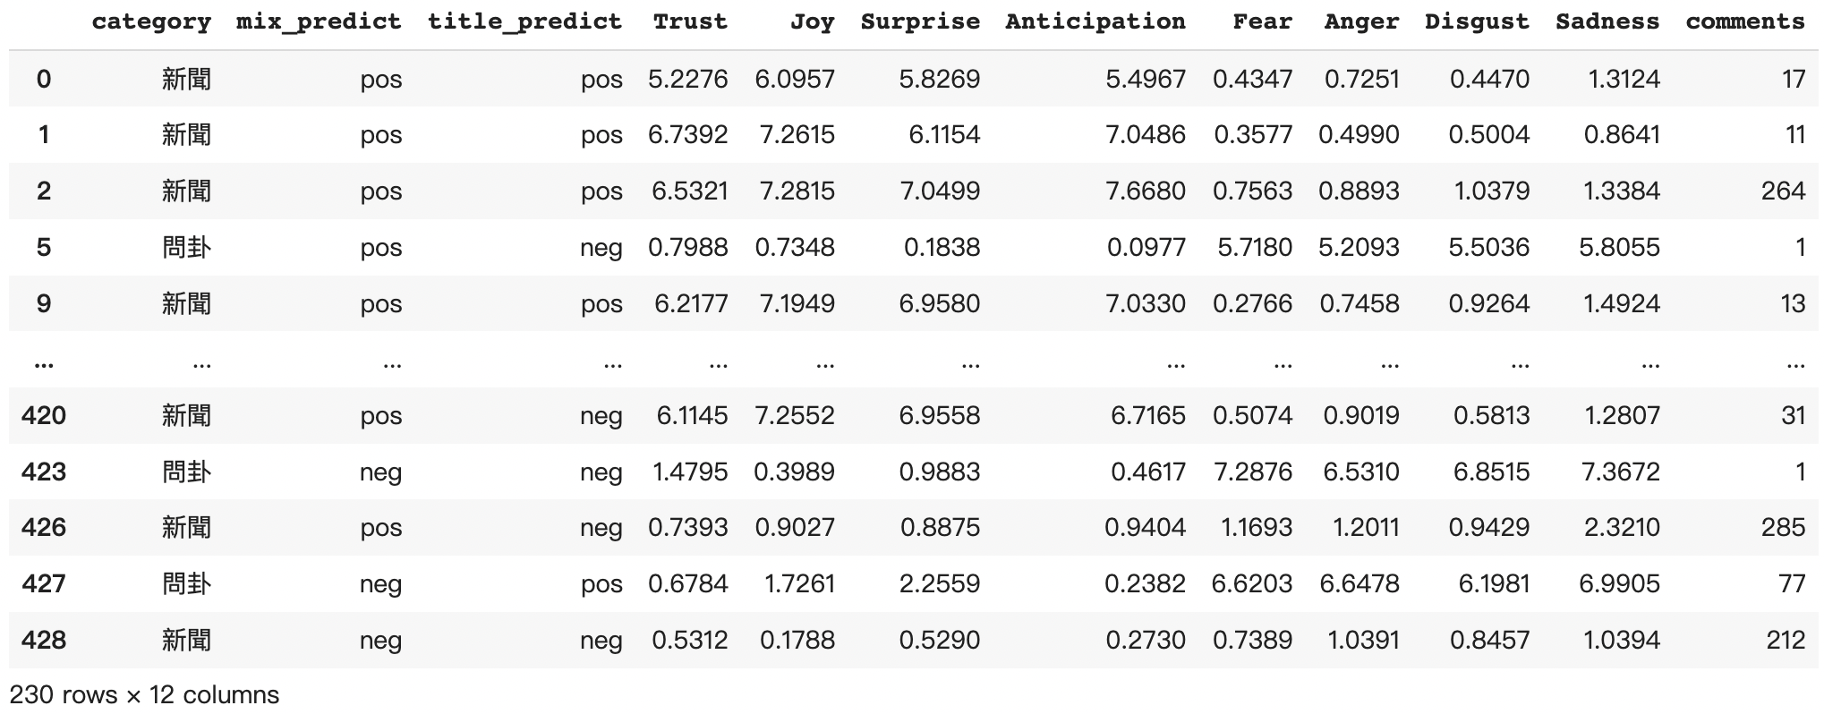
Random Forest - Remove Outliers

Slide 30
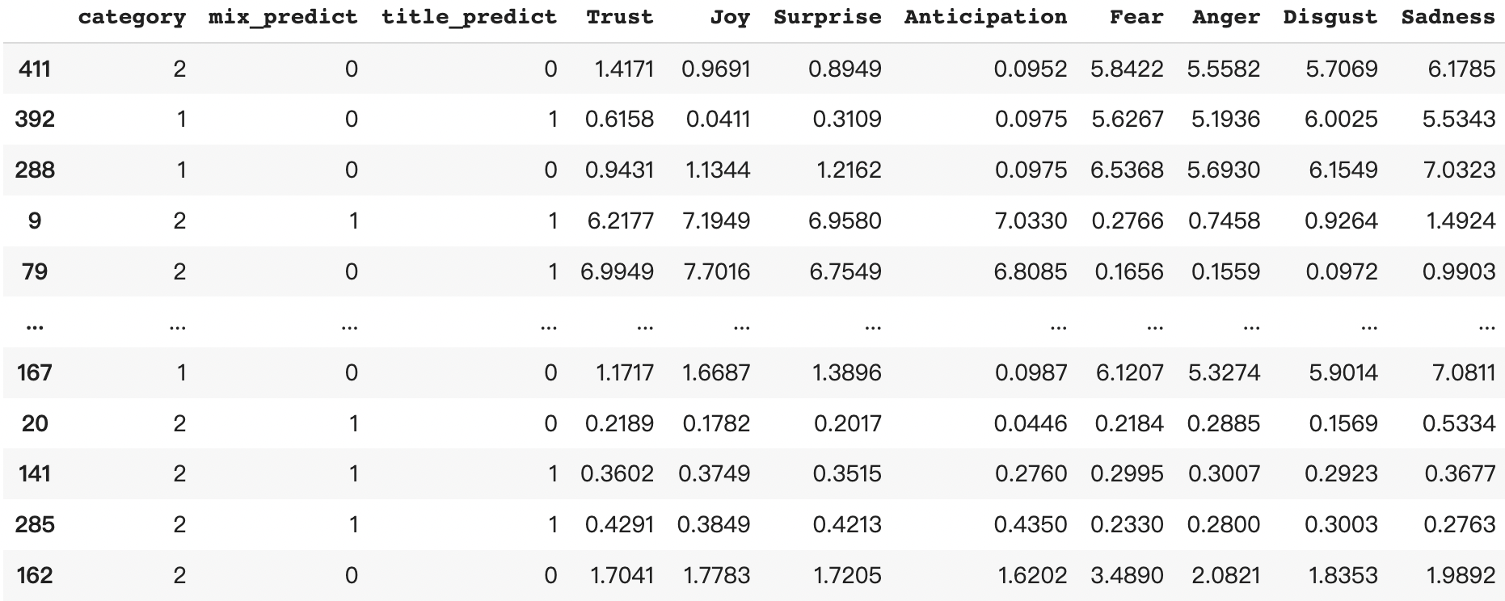
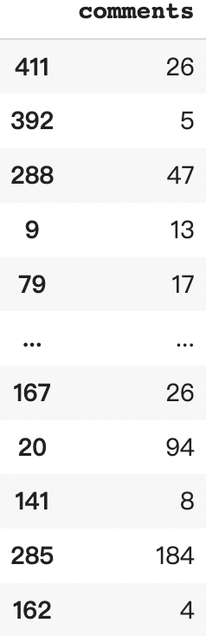
Random Forest - Split the training (70%) and testing set (30%)
Train X
Bert results + Keymoji scores
Train Y
Comments
Notes:
n = 171

Slide 31
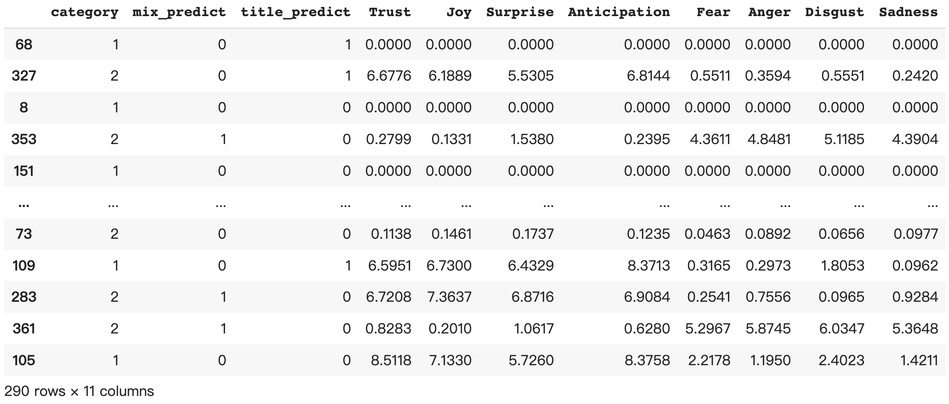
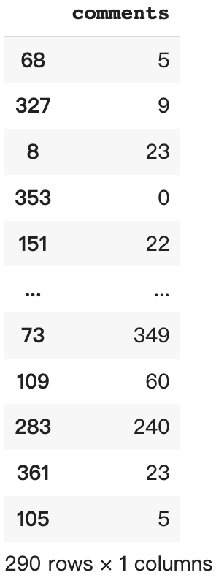
Random Forest - Split the training (70%) and testing set (30%)
Train X
Bert result + Keymoji scores
Train Y
Comments

Slide 32
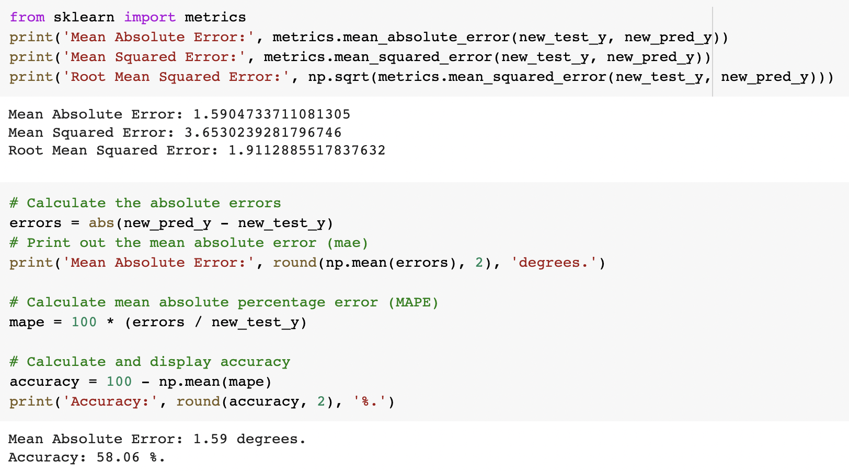
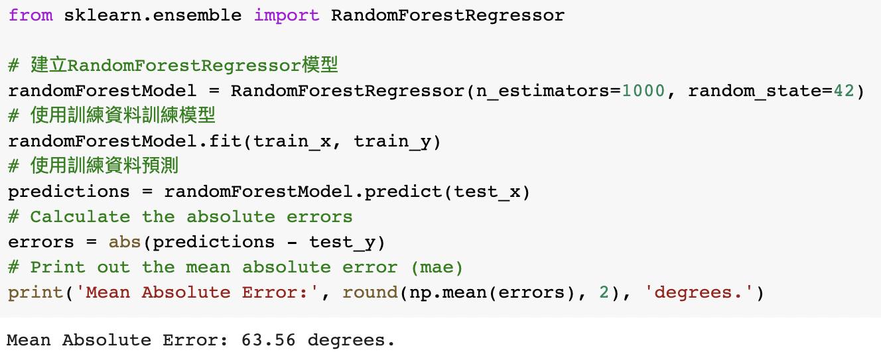
Accuracy

Slide 33
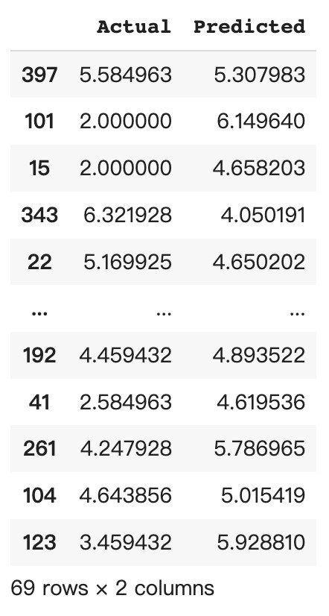
Result
Actual comment number of test set
vs.
Prediction

Slide 34
Result
Actual number of comments: 48
Our prediction: 40
Actual number of comments: 36
Our prediction: 18
Actual number of comments: 37
Our prediction: 27

Slide 35
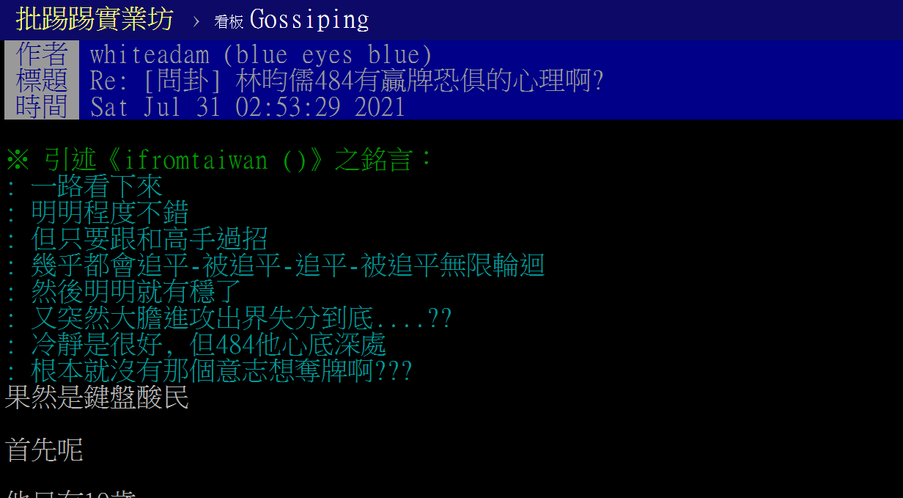
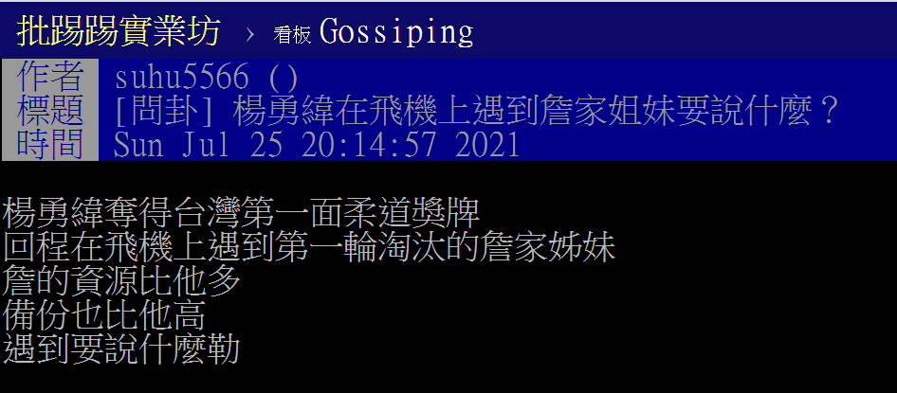
Result
Actual number of comments: 48
Our prediction: 40
Actual number of comments: 19
Our prediction: 19
Actual number of comments: 48
Our prediction: 48

Slide 36
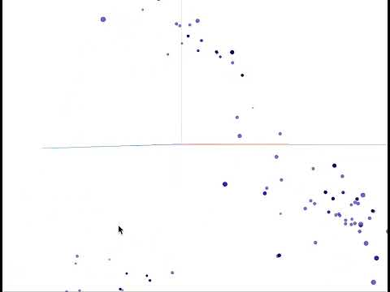
Visiualization

Slide 37
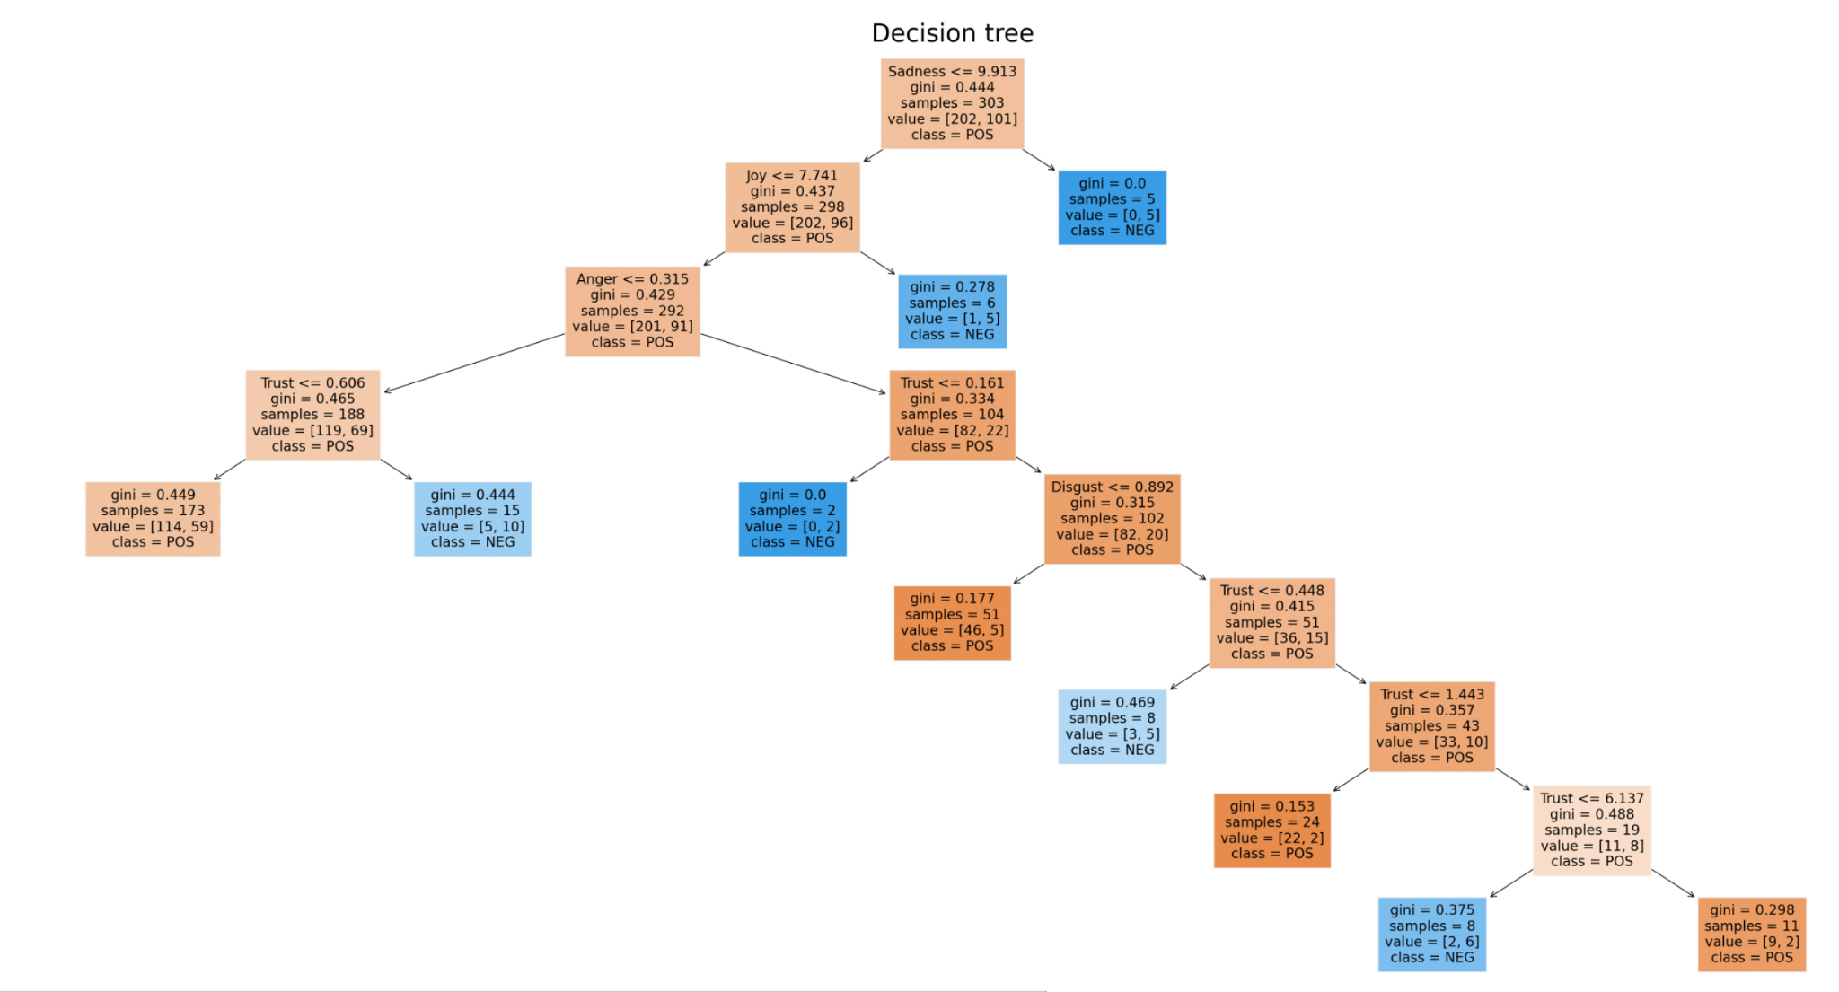

Slide 38
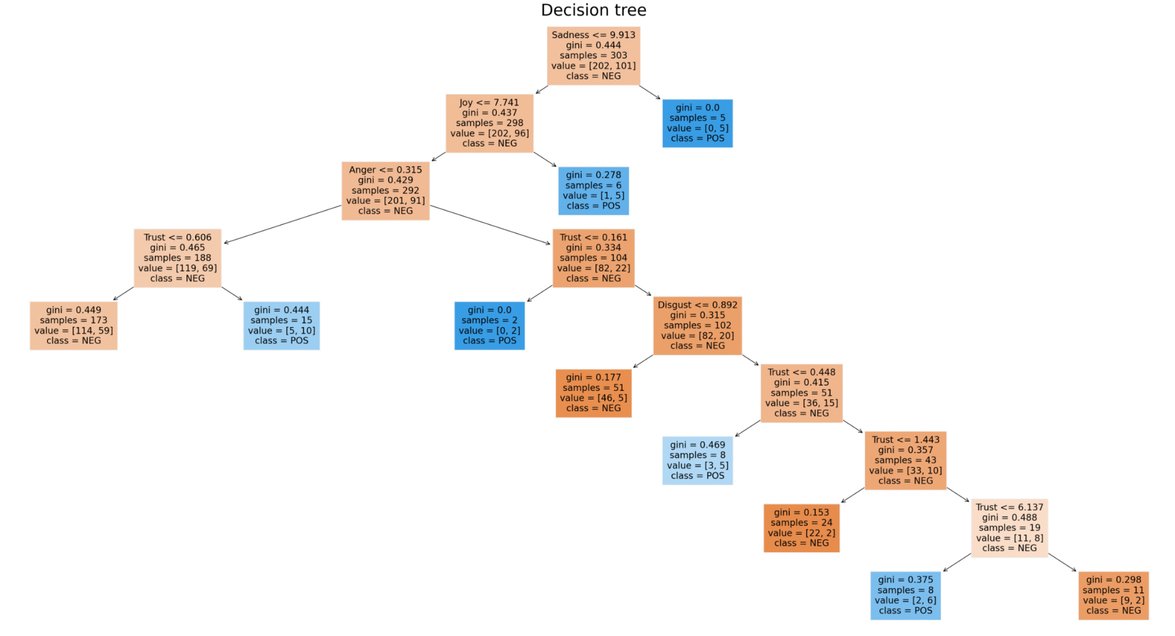

Slide 40
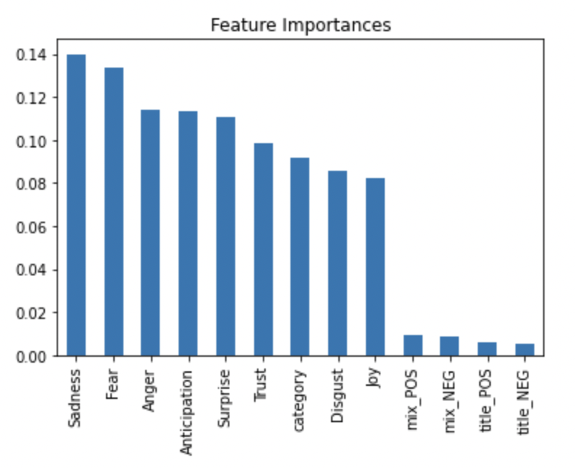
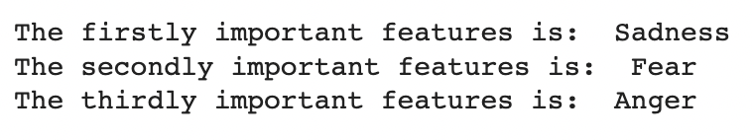
Feature Importance

Slide 41
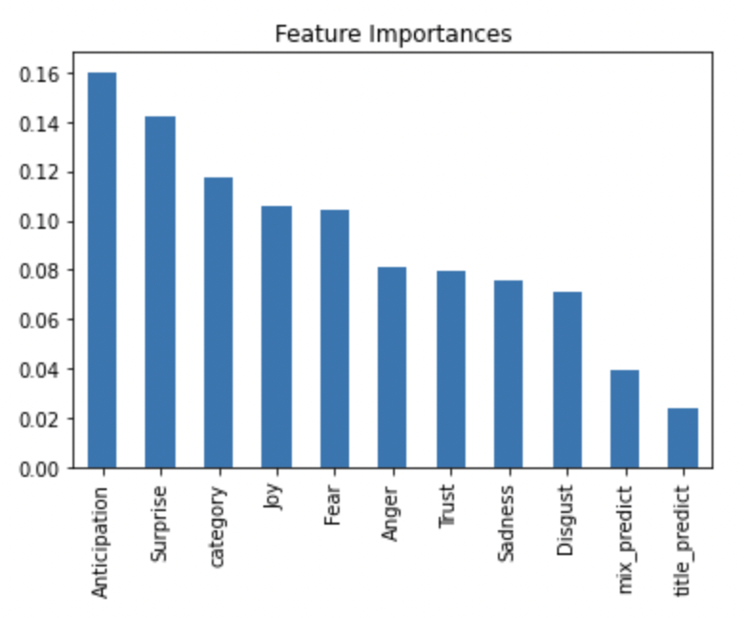
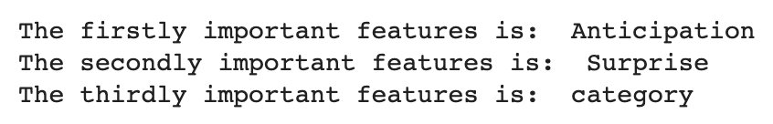
Feature Importance

Slide 42
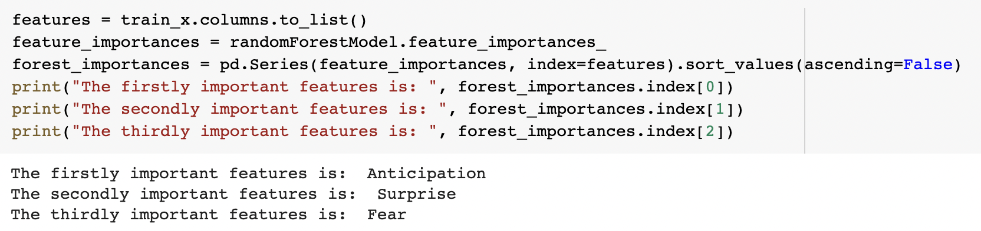
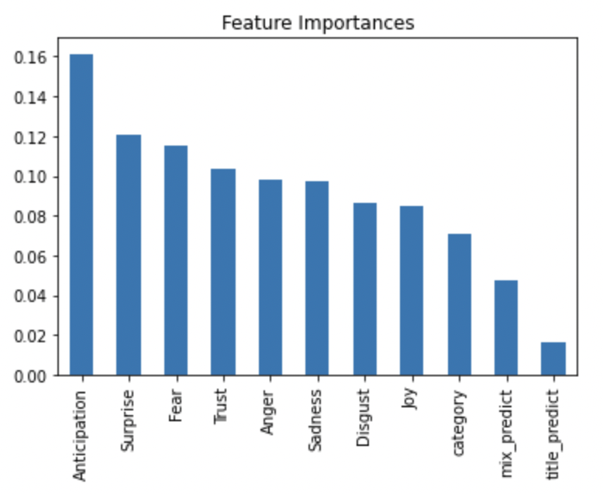
Feature Importance

Slide 43
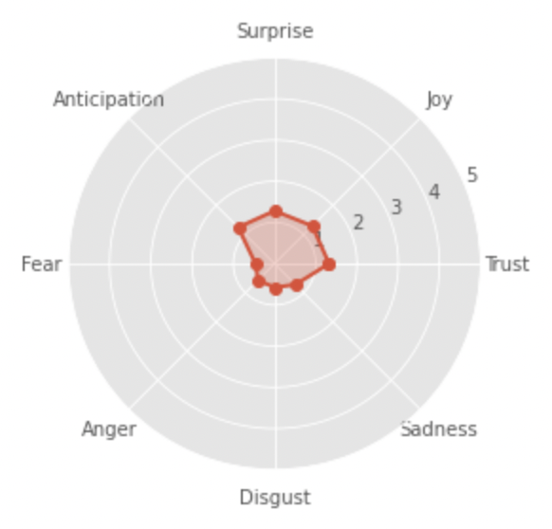
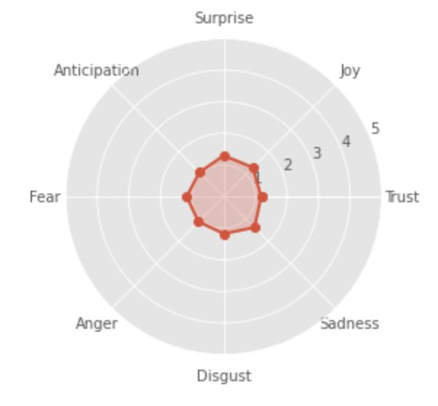
Outcome - Kuo Hsing-Chun (郭婞淳)
Title Only
Title + Content

Slide 44
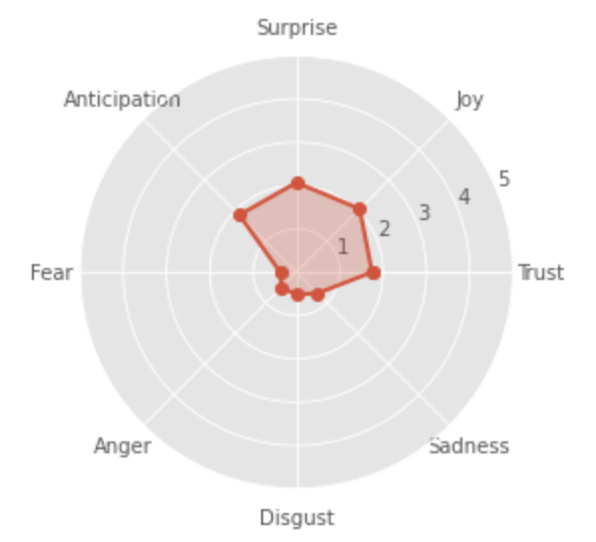

Outcome - Lee Chih-Kai (李智凱)
Title Only
Title + Content

Slide 45



Outcome - Lin Yun-Ju (林昀儒)
Title Only
Title + Content

Slide 46


Outcome - Tai Tzu-Ying (戴資穎)
Title Only
Title + Content

Slide 47


Outcome - Yang Yung-wei (楊勇緯)
Title Only
Title + Content

Slide 48


Compare Title Sentiment

Slide 49

Sentiment vs. Text Cloud
Content of Articles

Slide 50

Sentiment vs. Text Cloud
Content of Articles

Slide 51

Sentiment vs. Text Cloud
Content of Articles

Slide 52

Sentiment vs. Text Cloud
Content of Articles

Slide 53

Sentiment vs. Text Cloud
Content of Articles

Slide 54


Future Potential
Composite Model VS. Factor Model
Notes:
先講result
選一個預測最準的字串
加入mediator
探討interaction

Slide 55
Future Plan
Discover the discussion trend
How often or how long did the Taiwanese discuss athletes?
Automatic Cache Function
Function 1: Build the temp.folder to store the scraping content
Function 2: Reset the colab path for internal cache
Time info extraction
Explore how forgetful netizens are.
Sentiment analysis on the comments
Analyzing the sentiment of comments helps us to learn more about whether the Taiwanese view athletes positively or negatively.

Slide 56




Motivation & Objective
We love sport!
We enjoy watching sports events!
We support Taiwanese athletes!
To discover public awareness of Taiwanese sport events and athletes.
我們也熱衷酒精運動！

Slide 57
Topic
What do people think of Taiwanese athletes?

Slide 58

Technique - Text Cloud

Slide 59

Outcome-Tai Tzu-Ying (戴資穎)
Content of Articles
Comments

Slide 60

Outcome-Lin Yun-Ju (林昀儒)
Content of Articles
Comments

Slide 61

Outcome-Kuo Hsing-Chun (郭婞淳)
Content of Articles
Comments

Slide 62

Outcome-Lee Chih-Kai (李智凱)
Content of Articles
Comments

Slide 63

Outcome-Yang Yung-wei (楊勇緯)
Content of Articles
Comments

Slide 64
Group 5
hank You
Thank you
See you on 4/12 !
See you 6/21 !

